Slide 1
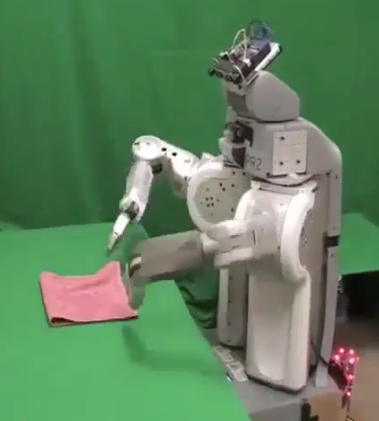
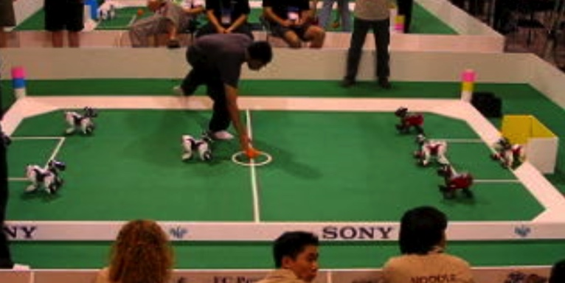
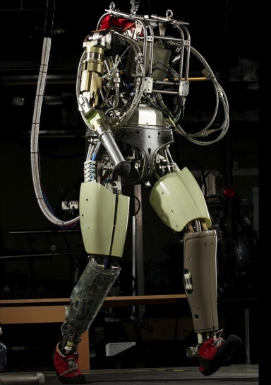
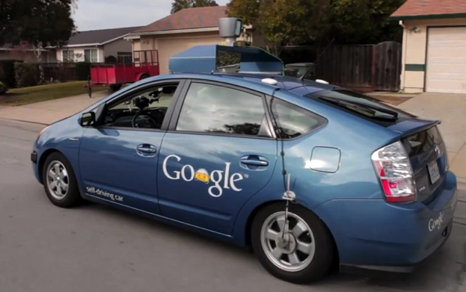
Robotics
Demo 1: ROBOTICS – soccer.avi
Demo 4: ROBOTICS – laundry.avi
Demo 2: ROBOTICS – soccer2.avi
Demo 5: ROBOTICS – petman.avi
Demo 3: ROBOTICS – gcar.avi
Robotics
Part mech. eng.
Part AI
Reality much
harder than
simulations!
Technologies
Vehicles
Rescue
Help in the home
Lots of automation…
In this class:
We ignore mechanical aspects
Methods for planning
Methods for control
Images from UC Berkeley, Boston Dynamics, RoboCup, Google

Slide 2
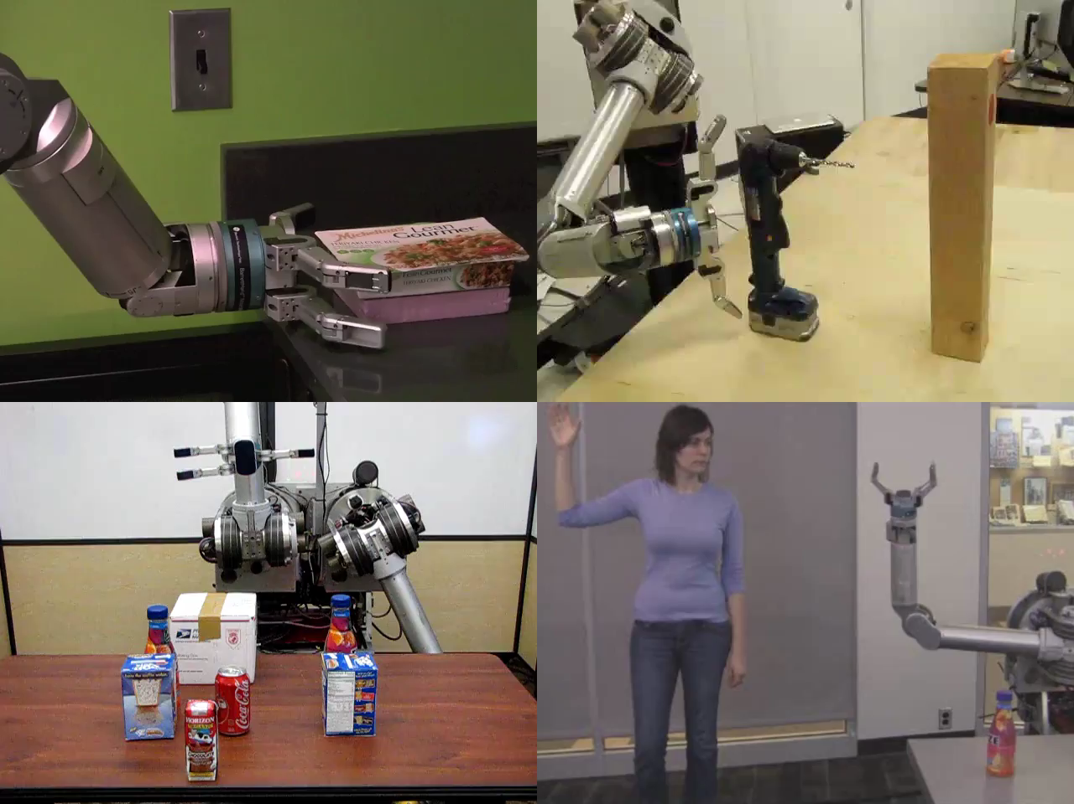
Robots

Slide 3

Robots
[Levine*, Finn*, Darrell, Abbeel, JMLR 2016]

Slide 4
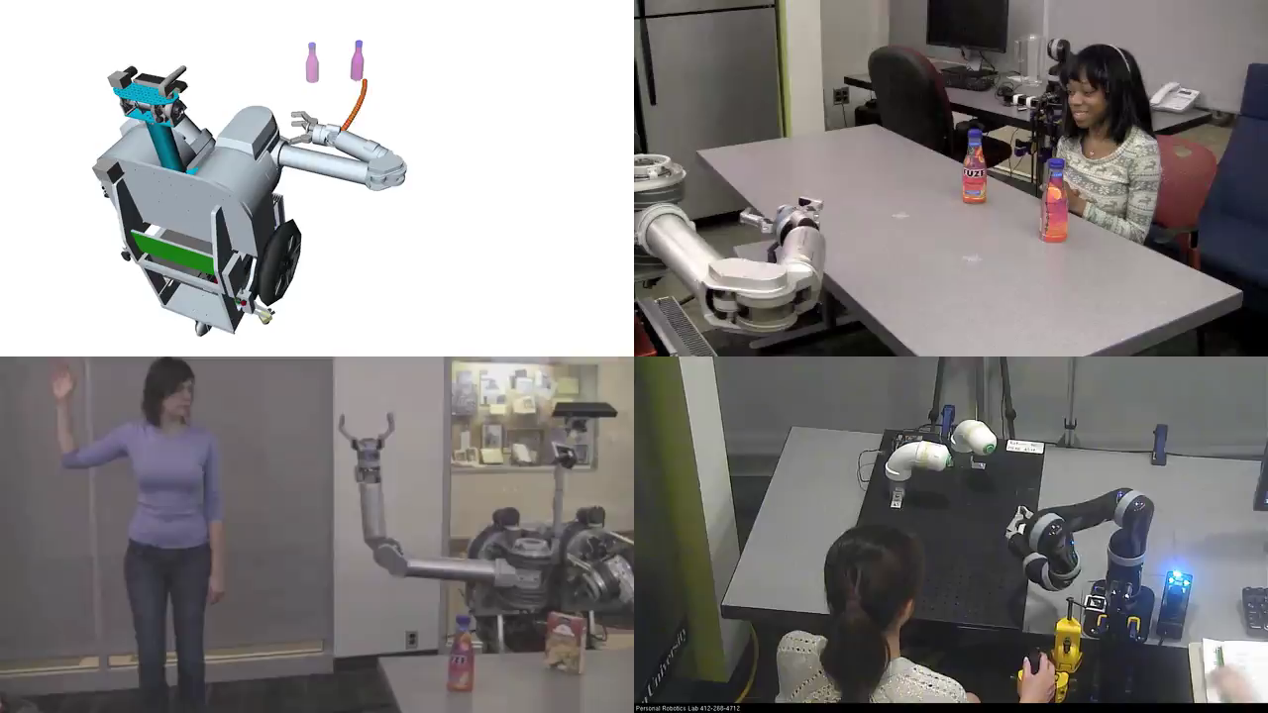
Human-AI Interaction

Slide 5
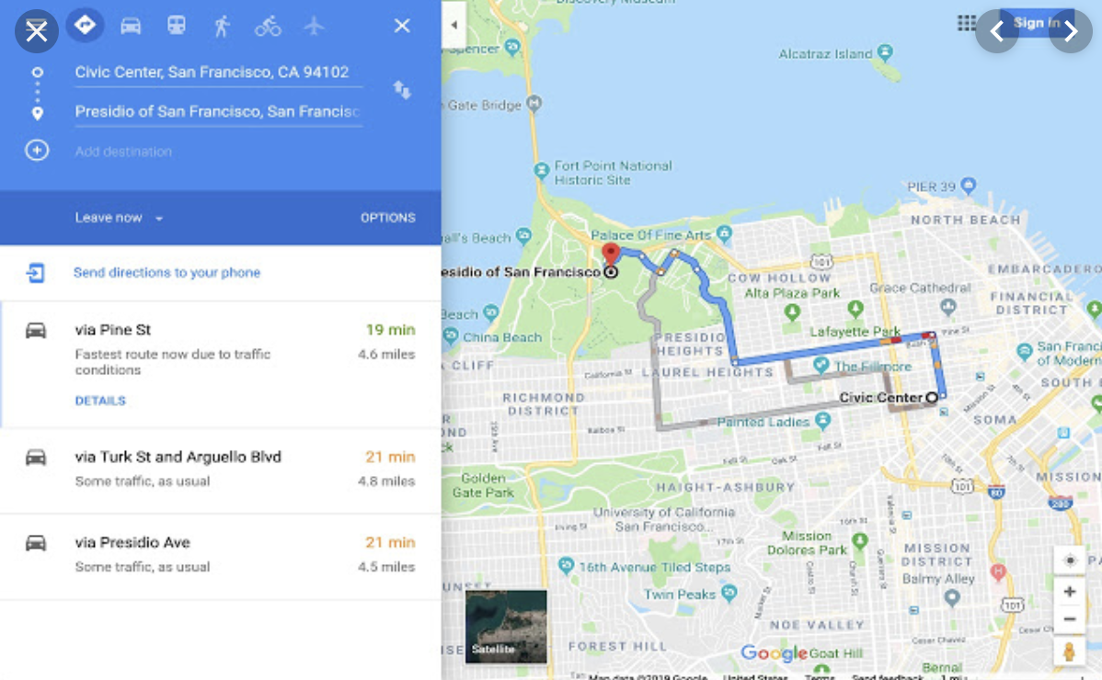
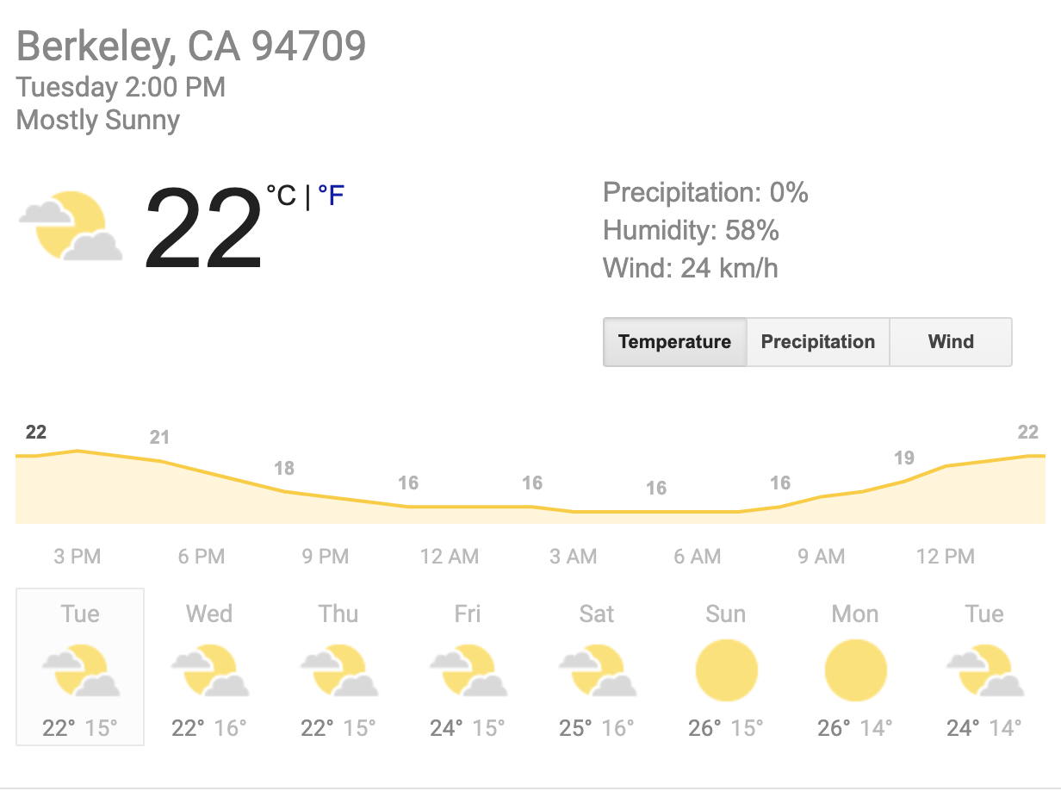


Tools for Predictions & Decisions

Slide 6




Natural Language
Speech technologies (e.g. Siri)
Automatic speech recognition (ASR)
Text-to-speech synthesis (TTS)
Dialog systems
Language processing technologies
Question answering
Machine translation
Web search
Text classification, spam filtering, etc…

Slide 7
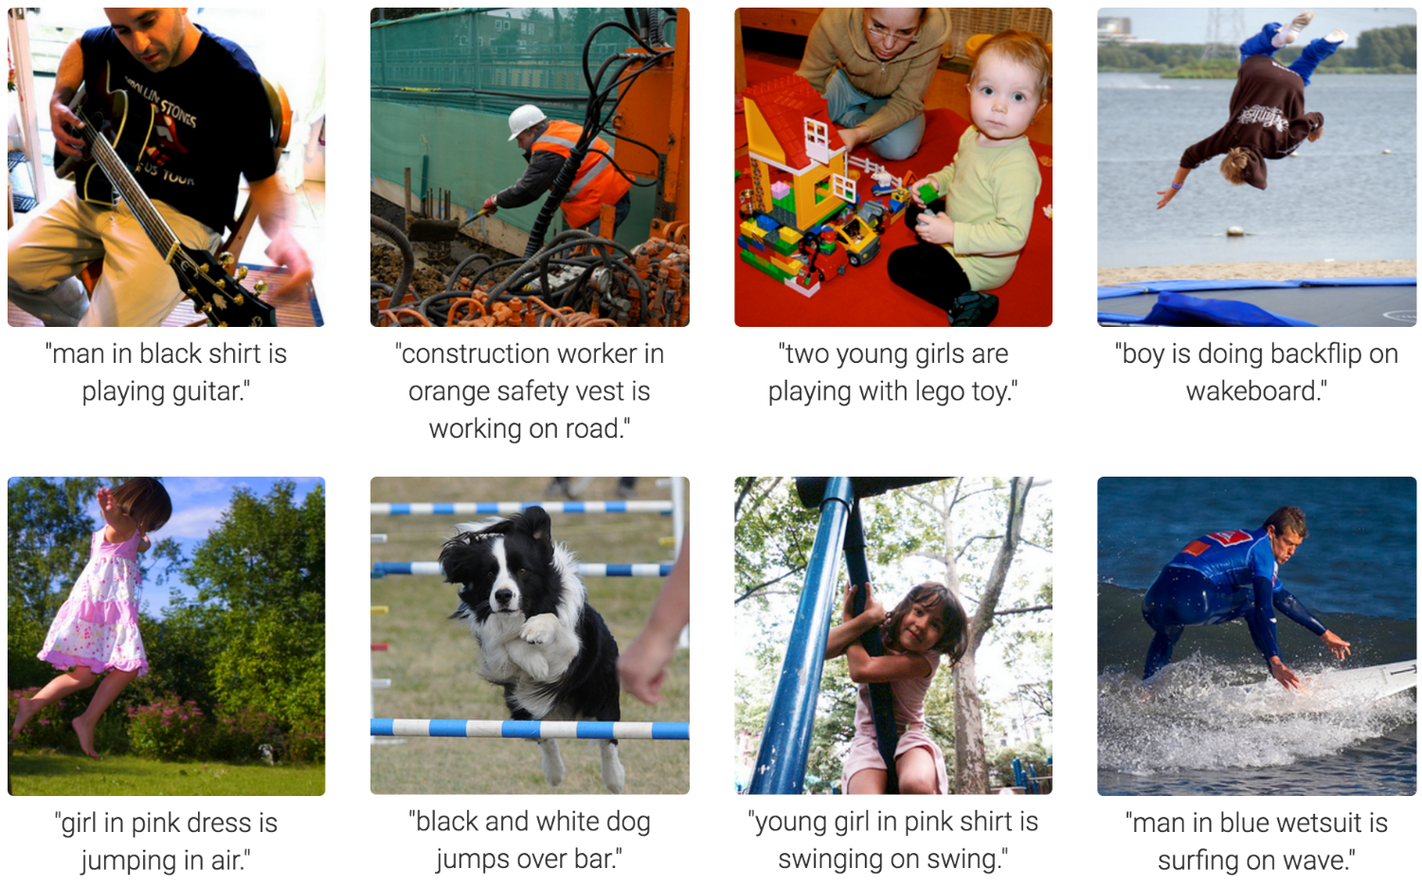
Computer Vision
Karpathy & Fei-Fei, 2015; Donahue et al., 2015; Xu et al, 2015; many more

Slide 8
Topics
Constraint satisfaction, e.g. scheduling
Search, planning, reinforcement learning, e.g. routing, robot navigation
Probabilistic inference, e.g. robot localization
A bit of supervised machine learning, e.g. spam detection

Slide 9
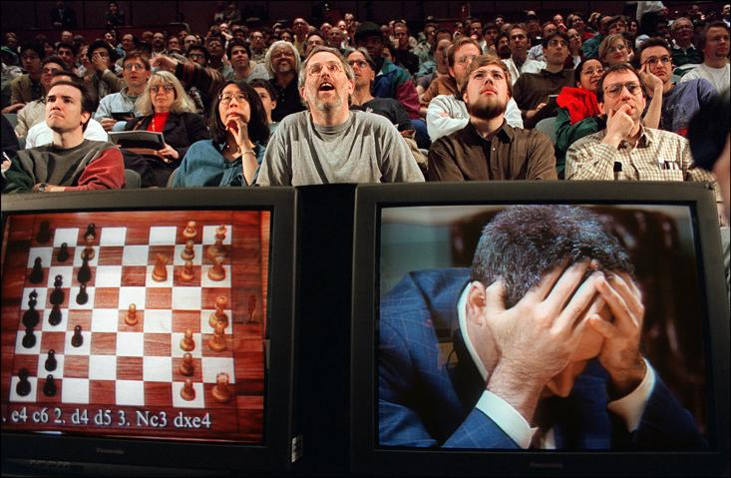
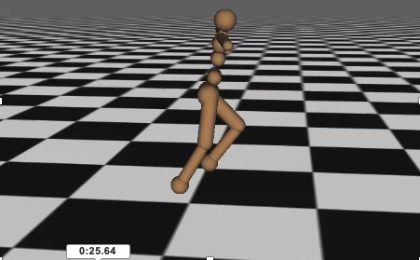

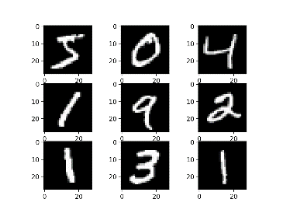
The kinds of AI problems in 188
(*)briefly in our ML topic
(*) need continuous time versions

Slide 10
Should I take 188?
Yes, if you want to know how to design rational agents!
188 also teaches you a different way of thinking.
Disclaimer: If you’re interested in making yourself more competitive for AI jobs, 189 and 182 are actually much better fits.

Slide 11
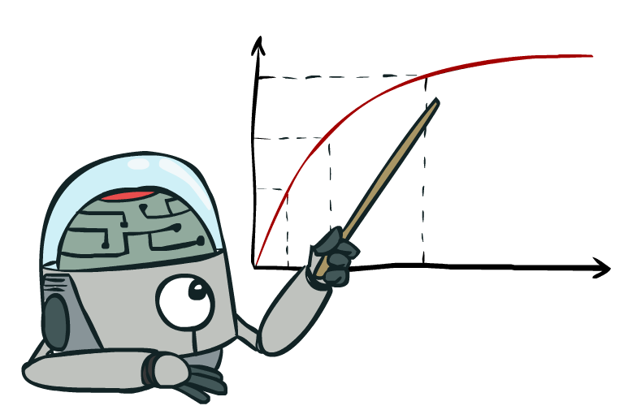
Maximize Your
Expected Utility

